Slide 1
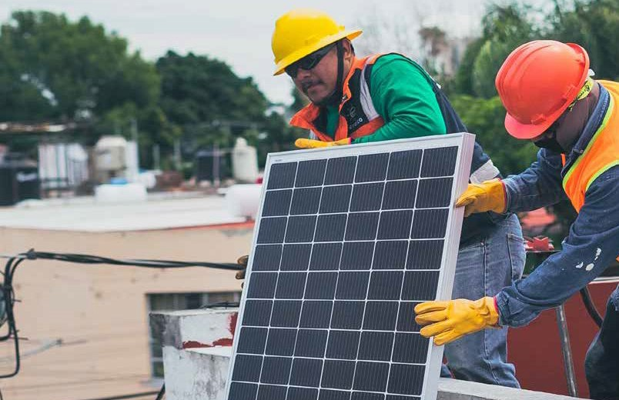
Assessment of jobs creation potential of NDC Renewable Energy targets with focus in Africa
13th International Conference on Applied Energy
Stelios Grafakos, Hanna Kim, Diana Quezada Avila, Frank Rijsberman
Global Green Growth Institute

Slide 2
Employment Opportunities
of NDC RE Targets of selected GGGI countries
Review and identify the NDC targets in the RE sectors as they have been reported by the countries in the NDC official documents.
1.
Identify the most labor-intensive technologies and practices in RE.
2.
3.
Assess the employment creation potential
of countries’ NDC RE targets.
4.
Provide recommendations on how to align countries’ economic recovery plans
ASSESSMENT OBJECTIVES
Notes:
Solar PV, wind, Hydro, geothermal and biomass

Slide 3
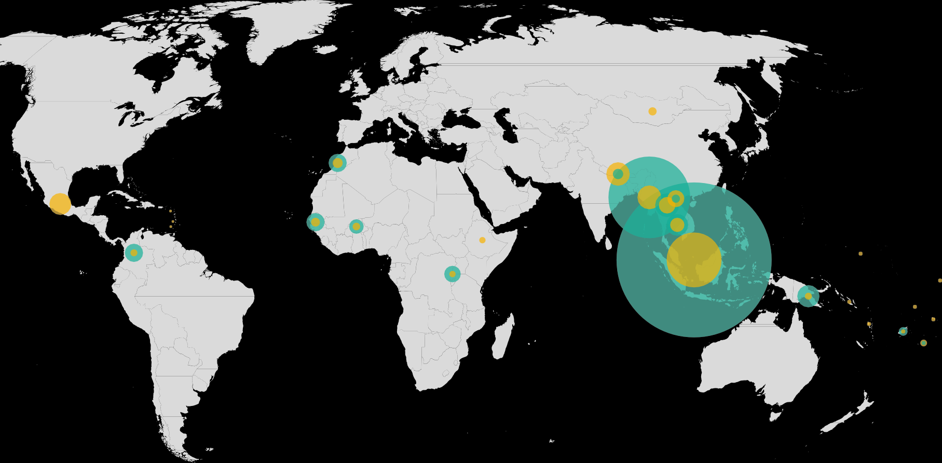
Jobs creation potentail in the energy and forestry sectors
ASIA (8)
OCEANIA (8)
Fiji Kiribati
Papua New Guinea Samoa
Solomon Islands Tonga
Tuvalu Vanuatu
Energy Forestry
Cambodia Jordan Indonesia Lao PDR Mongolia Myanmar Nepal Viet Nam
AFRICA (5)
Burkina Faso Ethiopia Morocco Rwanda Senegal
CARIBBEAN (3)
Antigua and Barbuda Grenada
St. Lucia
LATIN AMERICA (2)
Colombia Mexico
INTRODUCTION

Slide 4
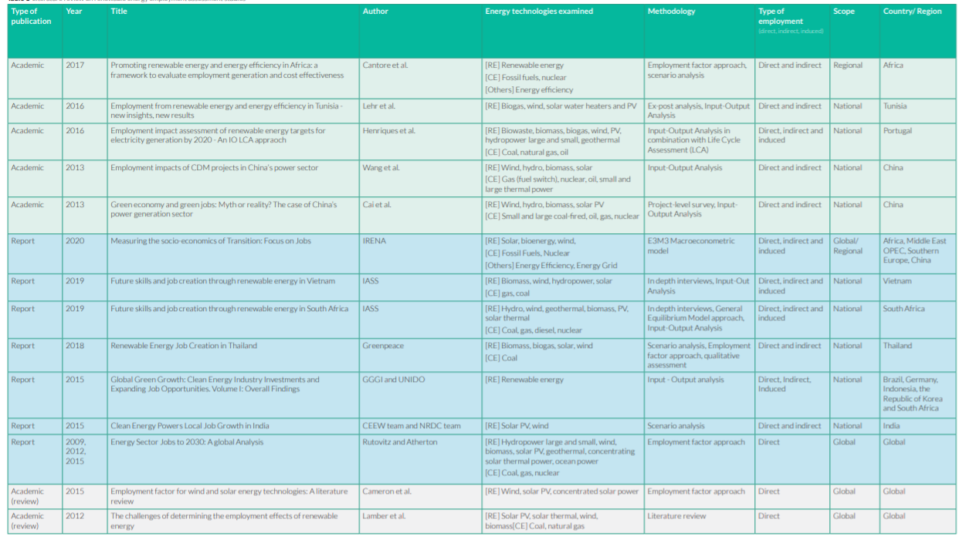
Relevant Literature
Rutovitz et al. (2015),
Cantore et al (2017),
Ram et al., (2020)
Total 174
Employment Factor
Values were utilized

Slide 5
Methodology
Adjustment of EFs for energy technologies

Slide 6
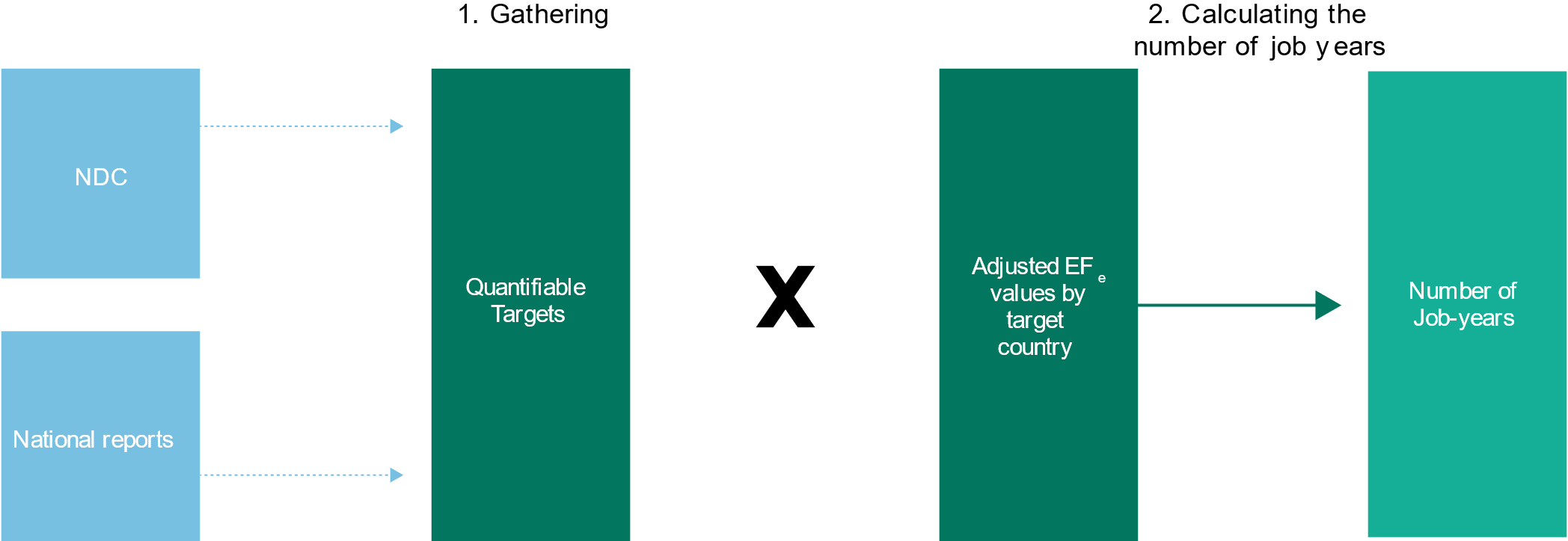
Methodology
EE approach for renewable energy technologies

Slide 7
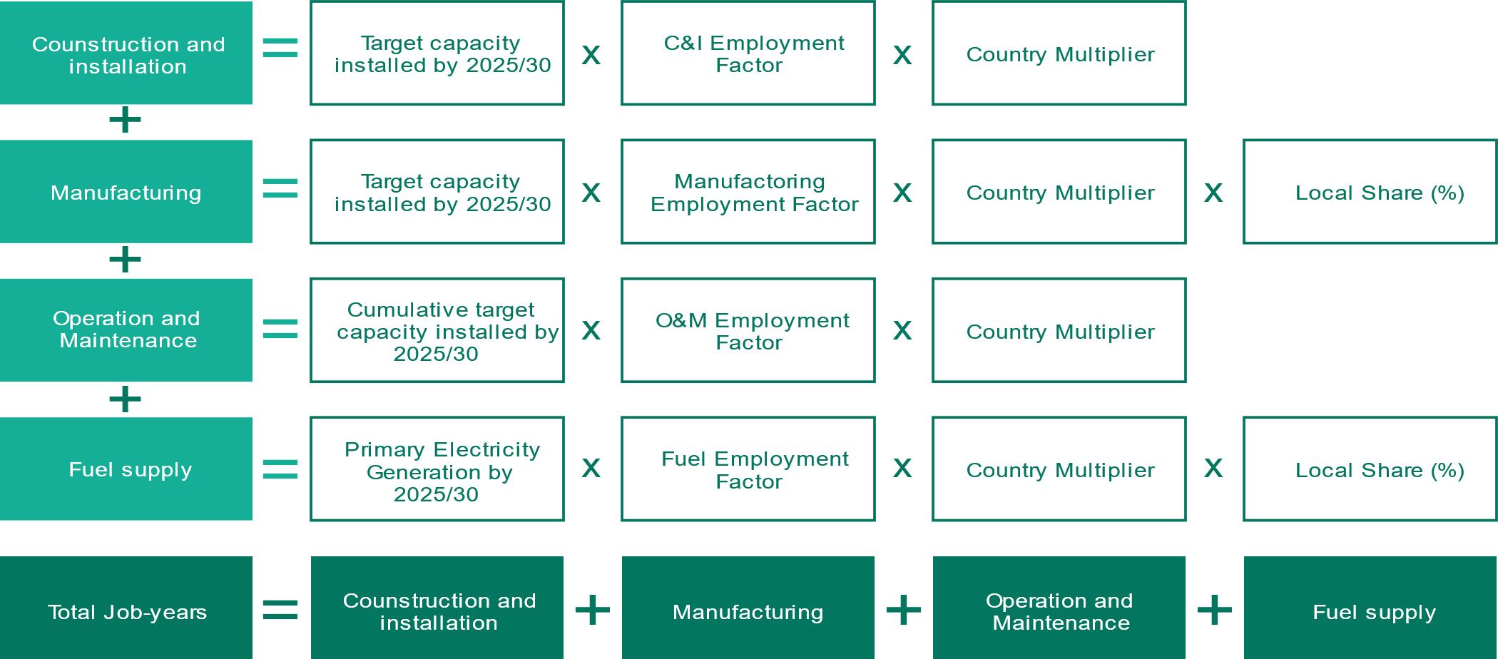
Methodology
Note 1: The cumulative job creation numbers between 2020 and the target year (2025/30) have been calculated.
Note 2: Local share for all value chain stages except manufacturing and fuel supply has been assumed to be 100%.
Job creation assessment calculations

Slide 8
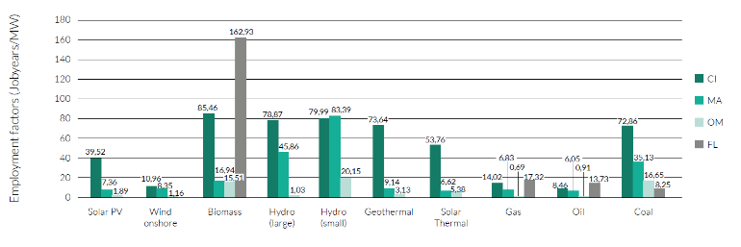
Adjusted employment factors for Africa (median values)

Slide 9
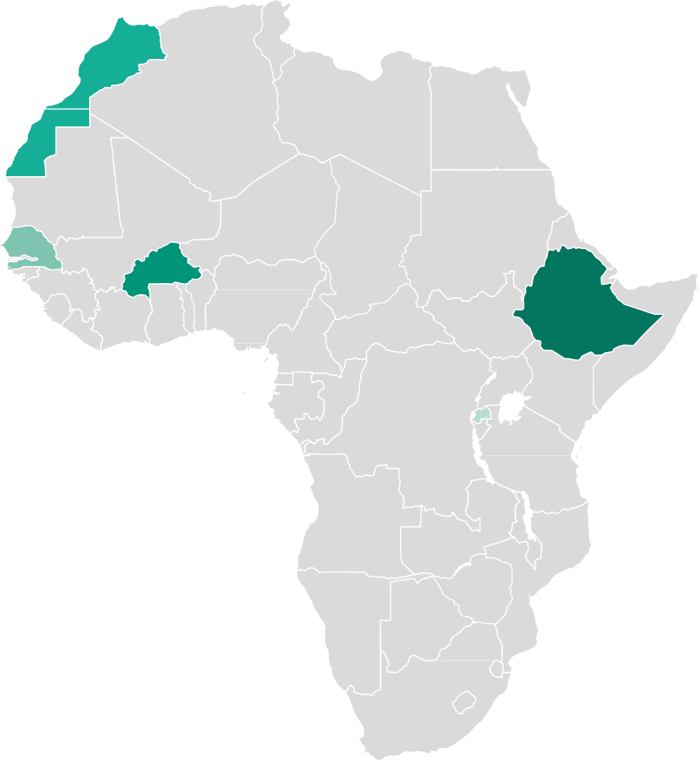
Assessing Direct Renewable Energy
Employment in Developing & Emerging Economies
Job creation in the renewable energy sector in Member/ target countries in AFRICA cumulatively up to the target year
Morocco
136
5,378 MW
Senegal
40
690 MW
Ethiopia
401
4,154 MW
Burkina Faso
96
1,018 MW
Rwanda
31
156 MW
Numbers in thousands
Notes:
- All target countries in the African region generate a considerable amount of electricity from hydropower. The results present significant employment impacts not just in hydropower but also in other RE deployment, namely solar PV and biomass.
In fact, when compared to oil, solar PV deployment can create 4.7 times more C&I job-years, biofuel 10 times more job-years, and small hydropower 9.5 times more job-years. Similarly, job-years in the manufacturing sector are more abundant in RE technologies than in oil.
Job creation could occur beyond the utility scale RE technologies. For instance, if Ethiopia were to achieve its Sustainable Development Goal 7 (Affordable and clean energy), wind power, geothermal, and biomass should be incorporated in the energy mix—which has been reflected in the 2030 targets proposed in the Sustainable Energy for All report.

Slide 10
Africa: Break down of jobs creation per RE sector

Slide 11
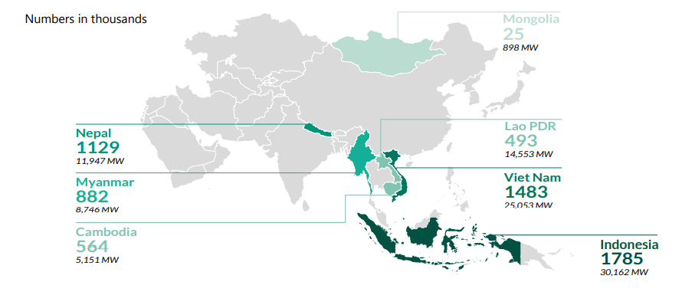
Assessing Direct Renewable Energy
Employment in Developing & Emerging Economies
Job creation in the renewable energy sector in Member/ target countries in ASIA cumulatively up to the target year

Slide 12
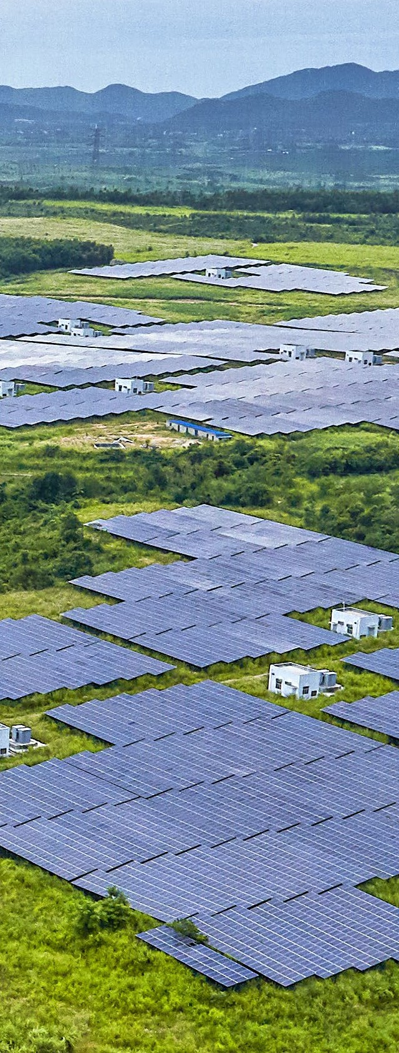
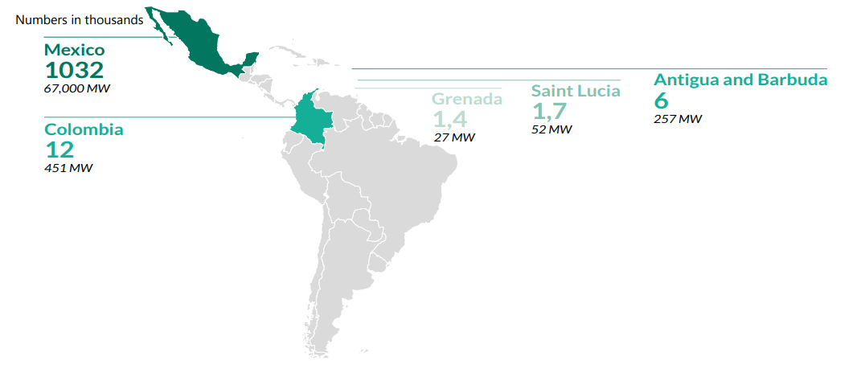
Assessing Direct Renewable Energy
Employment in Developing & Emerging Economies
Job creation in the renewable energy sector in Member/ target countries in LATIN AMERICA and the CARIBBEAN cumulatively up to the target year

Slide 13
Jobs created per USD million invested
Energy
Solar PV | 53
Biomass | 55
Hydro /Large | 19
Geothermal | 14
Wind Onshore | 11
This comparison is based only on the quantitative analysis that was conducted. It is worth looking in more detail into the qualitative aspects (e.g. wages, social security, decency) of jobs creation in the renewable energy sector compared to fossil-fuel based technologies .

Slide 14
Conclusions and future research
This study concludes that for the 27 GGGI Members, including emerging and developing economies that had quantifiable RE targets in their NDCs, implementation of these commitments would lead to more than 10 million job-years for the 11-year period until 2030.
RE offer significant opportunities for green job creation in developing and emerging economies. RE investments can generate 10–50 direct job-years per million USD invested. RE investments produce more jobs than their fossil-fuel alternatives for every million USD invested.
Further research and analysis is needed to estimate the net employment creation of NDC targets by comparing NDC employment scenario to the BAU employment scenario. In-depth studies in counties are also needed to analyze the potential of jobs creation of climate action and access to energy for all, productive used of energy particular in the context of Africa.

Slide 15
The Role of Renewable Energy for Green Recovery
Linking medium- to long-term green recovery measures to NDCs and national SDG targets to reiterate the government’s commitments toward clean energy and the energy transition.
Simultaneously investing in training or retraining programs to address the skills gaps in the RE and energy efficiency sectors.
Decarbonizing end-use fossil fuel–consuming sectors by scaling up renewables or low-carbon energy options.
Estimating the affordability and the economic, social, and environmental co-benefits of green recovery projects in the energy sector to support policy decision-making.
Deploying decentralized RE solutions to address the most vulnerable populations.
Strengthening the overall energy system to ensure the stability and flexibility of the grid when increasing RE penetration and reduce distribution losses.
Phasing out fossil fuel subsidies and reallocating revenues toward investments in RE and energy efficiency.
8. Linking the provision of recovery support to environmental measures, particularly for SMEs and their value chains.
Best Practices to Boost Renewable Energy through Green Recovery Programs
9. Increasing private sector investments through restructuring financing approaches aligned with appropriate public-sector incentives.

Slide 16
Thank you

Slide 17
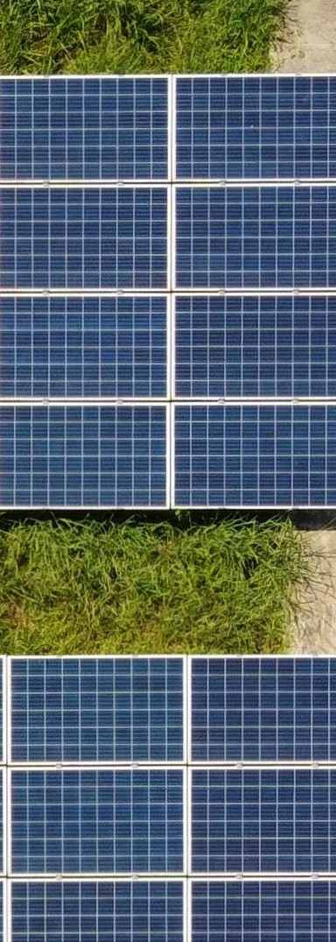
Jobs created in the energy sector when reaching the NDC energy generation targets
Share of FTE direct jobs created per technology, per groups of countries based on income level (%)
Geothermal Onshore Wind Solar PV Biomass Hydro
4,570,000
5.31%
11.21%
0.33%
26.86%
15.15%
1.39%
2,540,000
2,530,000
2,520,000
1,170,000
1,160,000
1,150,000
30,000
20,000
10,000
0
30.69%
83.12%
27.63%
25.94%
8.90%
41.14%
12.84%
9.49%
Middle Income Countries (MIC)
Low Income Countries (LIC)
Small Islands Developing States (SIDS)
Assessed countries per income level group

